Slide 1
To convert ER Models into relational table

Slide 2
Following rules are used for converting an ER diagram into the tables-
Rule-01: For Strong Entity Set With Only Simple Attributes-
A strong entity set with only simple attributes will require only one table in relational model.
Attributes of the table will be the attributes of the entity set.
The primary key of the table will be the key attribute of the entity set.

Slide 3
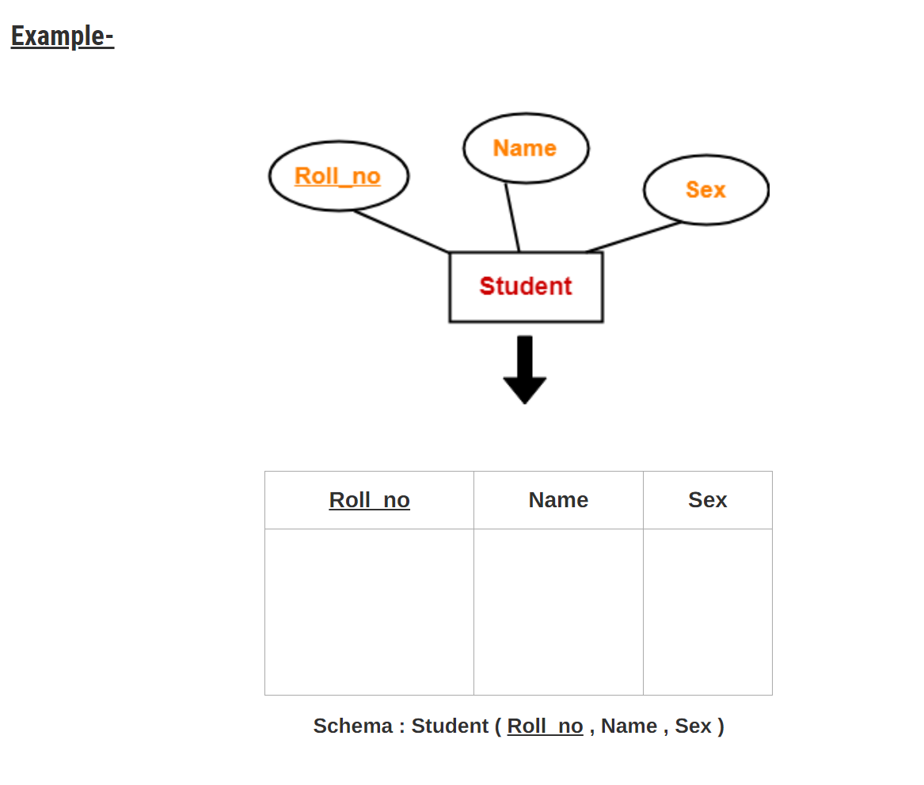

Slide 4
Rule-02: For Strong Entity Set With Composite Attributes-
A strong entity set with any number of composite attributes will require only one table in relational model.
While conversion, simple attributes of the composite attributes are taken into account and not the composite attribute itself.

Slide 5
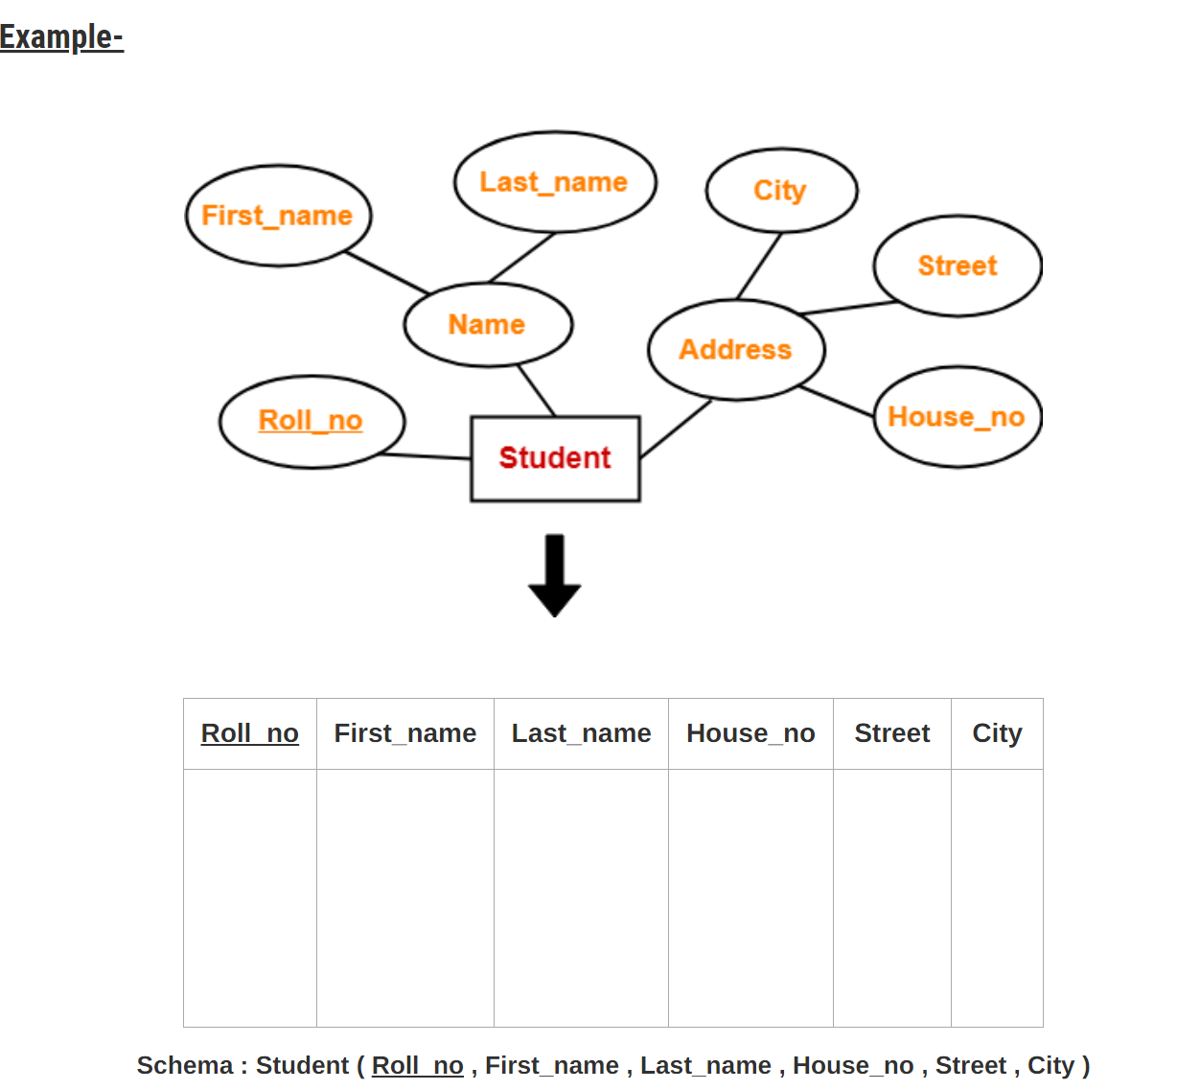

Slide 6
Rule-03: For Strong Entity Set With Multi Valued Attributes-
A strong entity set with any number of multi valued attributes will require two tables in relational model.
One table will contain all the simple attributes with the primary key.
Other table will contain the primary key and all the multi valued attributes.

Slide 7
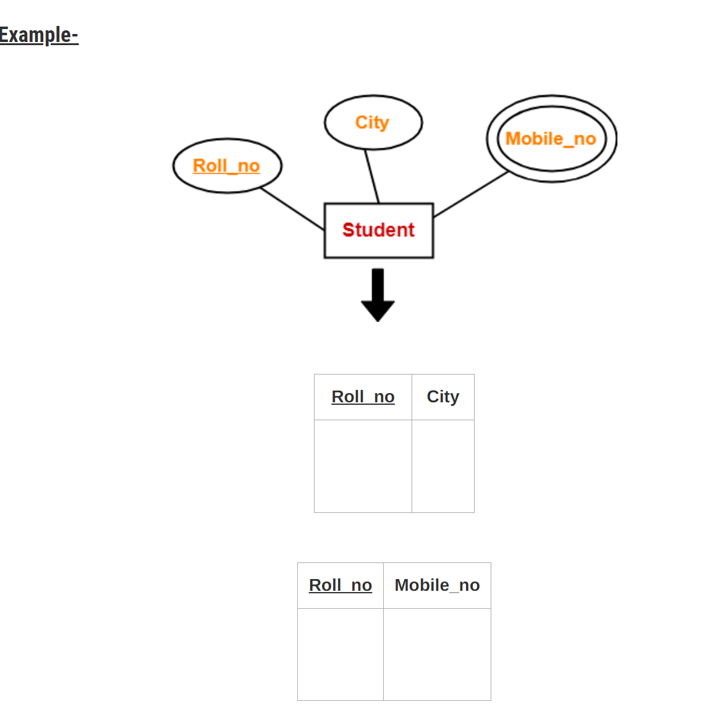

Slide 8
Rule-04: Translating Relationship Set into a Table-
Attributes of the table are-
Primary key attributes of the participating entity sets
Its own descriptive attributes if any.
Set of non-descriptive attributes will be the primary key.

Slide 9
